Slide 1
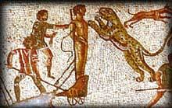
250 – 325 AD Plagues, Persecutions, Triumph (?)
Session 3

Slide 2
Key Events – Plague and Persecution
249-250 – Persecution under Decius – Origen arrested – survives the persecution but dies a few years later from the wounds inflicted
250-280 Plague of Cyprian (named after him because he refers to it)
– measles or smallpox
257/58 – Persecutions under Valerian – Cyprian martyred
260s – Peace for the Christians under Gallienus.

Slide 3
Decree of Gallienus -Toleration for Christians
“The Emperor Caesar Publius Licinius Gallienus Pius Felix Augustus to Dionysius, Pinnas, Demetrius, and the other bishops. The benefit of my bounty I have ordered to be proclaimed throughout the world. All places of worship shall be restored to their owners; you bishops, therefore, may avail yourselves of the provisions of this decree to protect you from any interference. The complete liberty of action which you now possess has long been granted by me; accordingly Aurelius Quirinius, my chief minister, will enforce the ordinance given by me.”
FYI – Christians always wanted the decrees in writing. Some officials chose to deliver the decrees orally and left room for “interpretation.”

Slide 4
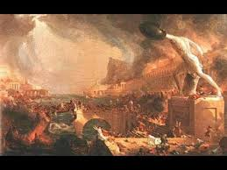
Political and Social Instability
Political instability and civil war
Barbarian (Franks, Allamans, Goths) from the West, Persian invasions from the East - SEE MAP –

Slide 5
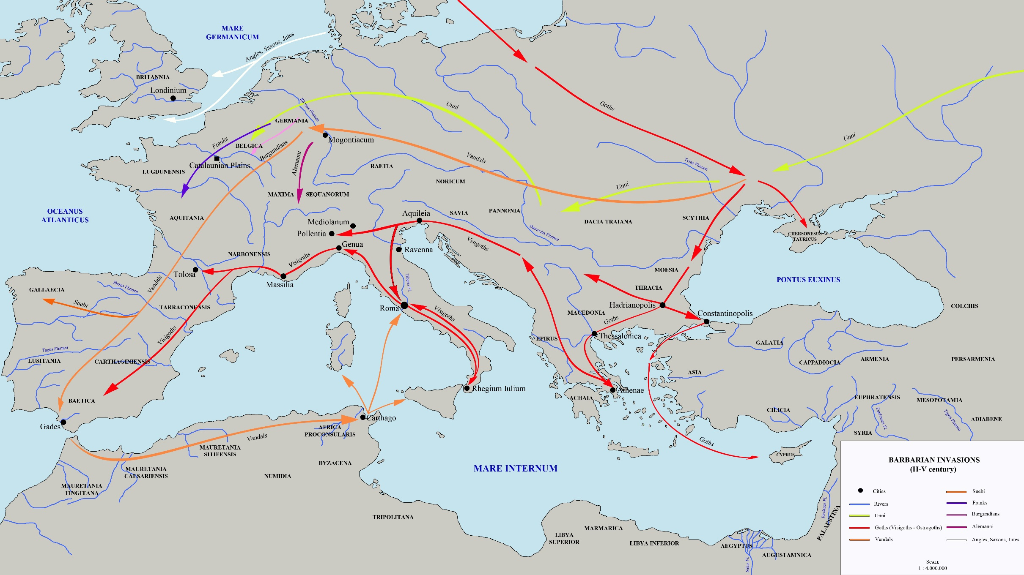

Slide 6
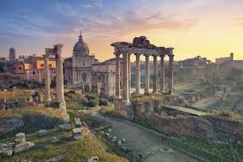
Political and Social Instability
Army and civil servants morale low - fleece the public – requisitioning crops and cattle, famine
A shrinking population/society turned upside down, aristocracy fading along with allegiance to the state among the middle class who are being taken advantage of by everyone
Money devalued – inflation on the rise

Slide 7
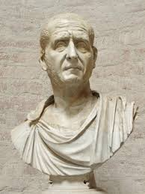
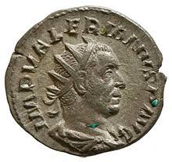
Decius, Valerian and Diocletian
[Decian persecution in 250-251 – first systematic
Began as a loyalty oath to emperor and Rome to unite empire in the face of fragmentation. Christians were blamed for all that went wrong
Sacrifice to Roman gods and the genius of the emperor
(issued libelli as proof of sacrificing to the gods)]
Jews exempt because they were a religio licita
Origen was arrested during this persecution
Valerian persecution (257 – Christian senators/Bishops focus of arrests and persecution) – Cyprian died under this persecution

Slide 8
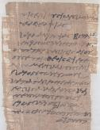
Copy of Libellus
To the commission chosen to superintend the sacrifices. From Aurelia Ammonous, daughter of Mystus, of the Moeris quarter, priestess of the god Petesouchos, the great, the mighty, the immortal, and priestess of the gods in the Moeris quarter. I have sacrificed to the gods all my life, and now again, in accordance with the decree and in your presence, I have made sacrifice, and poured a libation, and partaken of the sacred victims. I request you to certify this below.

Slide 9
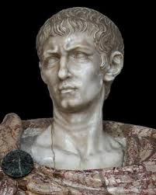
Diocletian (284-305)
After Decian and Valerian persecutions things died down for awhile and Christianity became a church prepared to absorb a whole society (Peter Brown)
Diocletian – period of stability for the empire
Diocletian’s (284-305) Reorganization - Tetrarchy
Diocletian (and successors) Persecution (304-311)
Eusebius says that Galerius (Little Caesar) was the cause
Began with the army and the loyalty oath
Emperor Licinius still persecuting Christians in 320s because of their allegiance to Constantine

Slide 10
After Diocletian
305 Diocletian and Maximian retire
East: Galerius becomes Augustus with Maximin Daia as little caesar
West: Constantius Chlorus becomes Augustus with Severus as little Caesar
When Constantius Chlorus is killed at York in 306 Constantine takes over (Constantine had been “going to school” in the East – more like house arrest to keep Constantius Chlorus in line)
Constantine defeats Maxentius at the Milvian Bridge (sees a vision) in 312 & Licinius defeats Maximain Daia in the East in 313

Slide 11
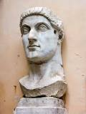
Triumph of Constantine
Toleration after Diocletian – kind of
Galerius (who had been fiercely persecuting the Christians) issues an edict of toleration in 311 (after he grew deathly ill)
Constantine and Licinius issue edict (letter) of Milan 313 that agrees to tolerate Christians and treat them benevolently
Constantine defeats Licinius in 323 and becomes sole emperor

Slide 12
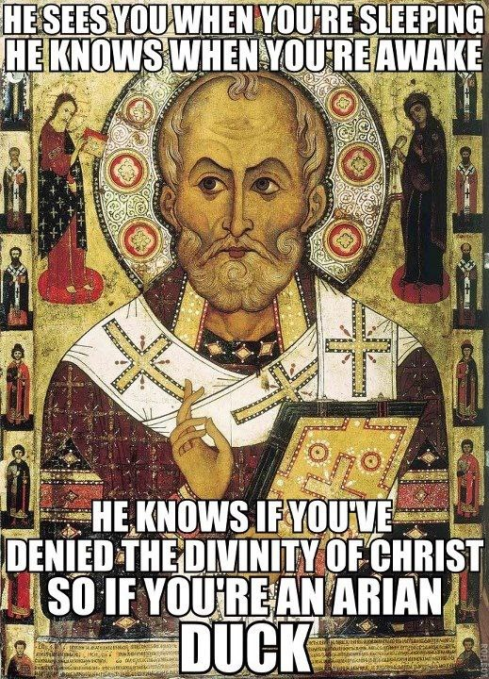
Calling of Council of Nicaea - 325
Calls Council of Nicaea in 325. Why?
Miletian Schism
Date of Easter
Trouble with Arius
Dispute took place in Alexandria but had larger implications for the empire; religious disputes end up affecting politics
Flurry of letter writing preceded Nicaea by Bishops
Constantine burns them all
Thought the religious dispute was “logomachy”

Slide 13
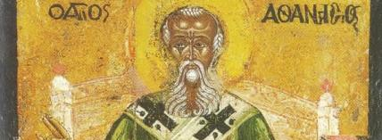
Key People
Roman Emperors: Decius, Valerian, Gallienus, Diocletian, Constantine
Cyprian
Novatian and Donatus – pure Christianity
Paul of Samosata and Lucian of Antioch
Peter of Alexandria and Miletus
Arius (ca 256/260-336) and Alexander (his bishop) – dispute starts ca 319/320
Athanasius (ca 297-373)

Slide 14
Key Issues - Paganism
Christianity and Paganism (Synod of Elvira 305/6 Grenada, Spain passed 81 canons)
Besides Rome’s old gods there were “an army of more exotic deities”
Egyptians had gods depicted as animals, cult of Isis
Syria and N. Africa had the fertility gods which promoted church growth
Asia Minor had the Great Mother – whose devotees castrated themselves
Religious people who wanted to placate the gods and looking for answers
Christianity stood out from these religions, but also appealed to a similar constituency
Even before Constantine, Christianity was well established in the culture and society

Slide 15
The Lapsi and Traditores
What to do with those who gave in (Lapsi) and sacrificed or handed over (Traditores) the books
Issue of libellus/libelli
Beginning of system of penance to deal with the sin of the persecution (initially pastoral care, later on becomes abused during the middle ages; Luther’s response)

Slide 16
The Lapsed (cont’d) and Purification of Church
Novatianism (250s)
Donatism (300s – lasts for a couple of centuries) –
Council of Carthage (312) and Rome (313) deal with Donatist controversy, as did Council of Arles (southern France) – key council
Donatists appealed twice to Constantine (they lost). Donatists come out in favor of separation of church and state
Can sacred acts done by clergy who apostatized be considered valid and certain?

Slide 17
Rebaptism?
Rebaptism of heretics- Councils in Africa – early and mid 3rd c. - Carthage and Alexandria – issue of Rebaptism if done by heretics
Cyprian said they should be rebaptized (Augustine disagreed)

Slide 18
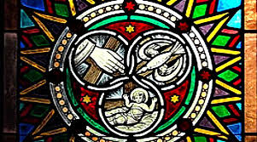
Trinitarian Issues
Sabellianism/Modalism – God appears in 3 different modes or forms (like illus. of H2O)
Adoptionism, dynamic monarchianism and Paul of Samosata – God adopted a human being (Jesus) who deserved to be adopted because he was so good. He received the divinity at his baptism when the Spirit of God rested on him.

Slide 19
Moral Issues
Clergy misconduct (Council at Narbonne (255-60 AD) – dealt with alleged clergy misconduct of Bishop Paul (he proves himself innocent by calling a synod)
Synod of Elvira (305/6, Grenada, Spain) passed 81 canons
Against pagan immoralities
Church discipline, strict morality enforced
Could lapsed be given communion on deathbed
Pictures on walls prohibited (becomes an issue again in the 7th /8th c – 7th ecumenical council (787) – question of icons perhaps also because of Islam?
Christians prohibited from marrying Jews (Judaism becomes attractive to some Christians)

Slide 20
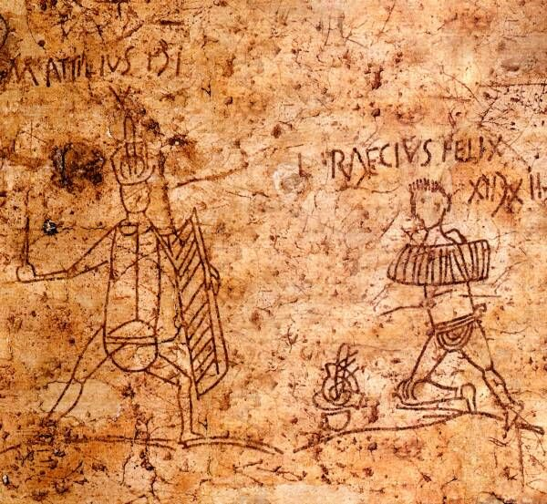
Council of Arles 312
Passed 22 canons on pastoral misconduct
Easter question
Condemned Donatists
Condemned races and gladiator fights
Condemned baptism of heretics
Bishops who apostatize are deposed but their acts honored

Slide 21
Council at Ancyra – 314 (Galatia)
Sought to heal wounds of Diocletian persecution
25 canons that deal with apostasy resulting from persecution (see esp. 1-8)
Priests who had apostatized could remain among clergy but not perform sacerdotal functions
If one sacrificed to the gods before Baptism he could still be admitted to the rank of clergy
Prescribed penance of 7 years for adultery and lifelong penance for murderers
Forbade chorepiscopoi from ordaining
Allowed deacons to marry who had declared their intentions before ordination

Slide 22
Council in Neocaesarea (between 314-325)
Questions about clergy misconduct
Canon I. Presbyters who marry are removed from clergy roster
Presbyters who fornicate are excommunicated
Questions about sexual misconduct in general – especially/even lust, expecting the clergy to come clean on these issues
Questions about plural marriages
Second marriages opposed
No one is to be ordained prior to 30 years of age
Canon 15 – 7 deacons per city – later effects . . .
319-325 Bunch of Councils in Alexandria in Egypt to deal with Arius

Slide 23
Lessons for the Church Today
Was Constantine good or bad for Christianity?

