Slide 1
Society, Culture and the Early Church
Or
The Christians and Their Culture
New Jersey District Pastors Conference
January 30-31, 2020
Professor Joel C Elowsky
Concordia Seminary, St. Louis

Slide 2
You know you’ve arrived when . . . .

Slide 3
Introductions

Slide 4
Schedule
Thursday, January 30
10:30-11:45: Session 1 (Mission and Culture in the Early Church)
11:45-1:00: Boxed lunch
1:00-2:15: Session 2 (2nd and 3rd Century Christianity: Defending the Faith from within and without)
2:15-2:45: Coffee break
2:45-4:00: Session 3 (Plagues, Persecution and the Triumph [?] of Christianity)
Friday, January 31
7:30-8:30: Continental breakfast
8:30-9:30: A Study of the Nicene Creed (325/381)

Slide 5
The Study of History and of the Early Church
A Cross-cultural enterprise
The Holy Spirit has a history (33-1500 AD – don’t skip)
Church Fathers and the Lutheran Confessions
How is the study of History similar/different from other disciplines?

Slide 6
The Study of History and of the Early Church
What is the early church and who are the early church fathers?
1. People Who are the church fathers and why call them fathers?
2. Spaces – Where did they worship? Where did they live?
3. Time (1st-5th c). Why restrict ourselves to this date?
4. Place – what area of the world are we talking about? (map)

Slide 7
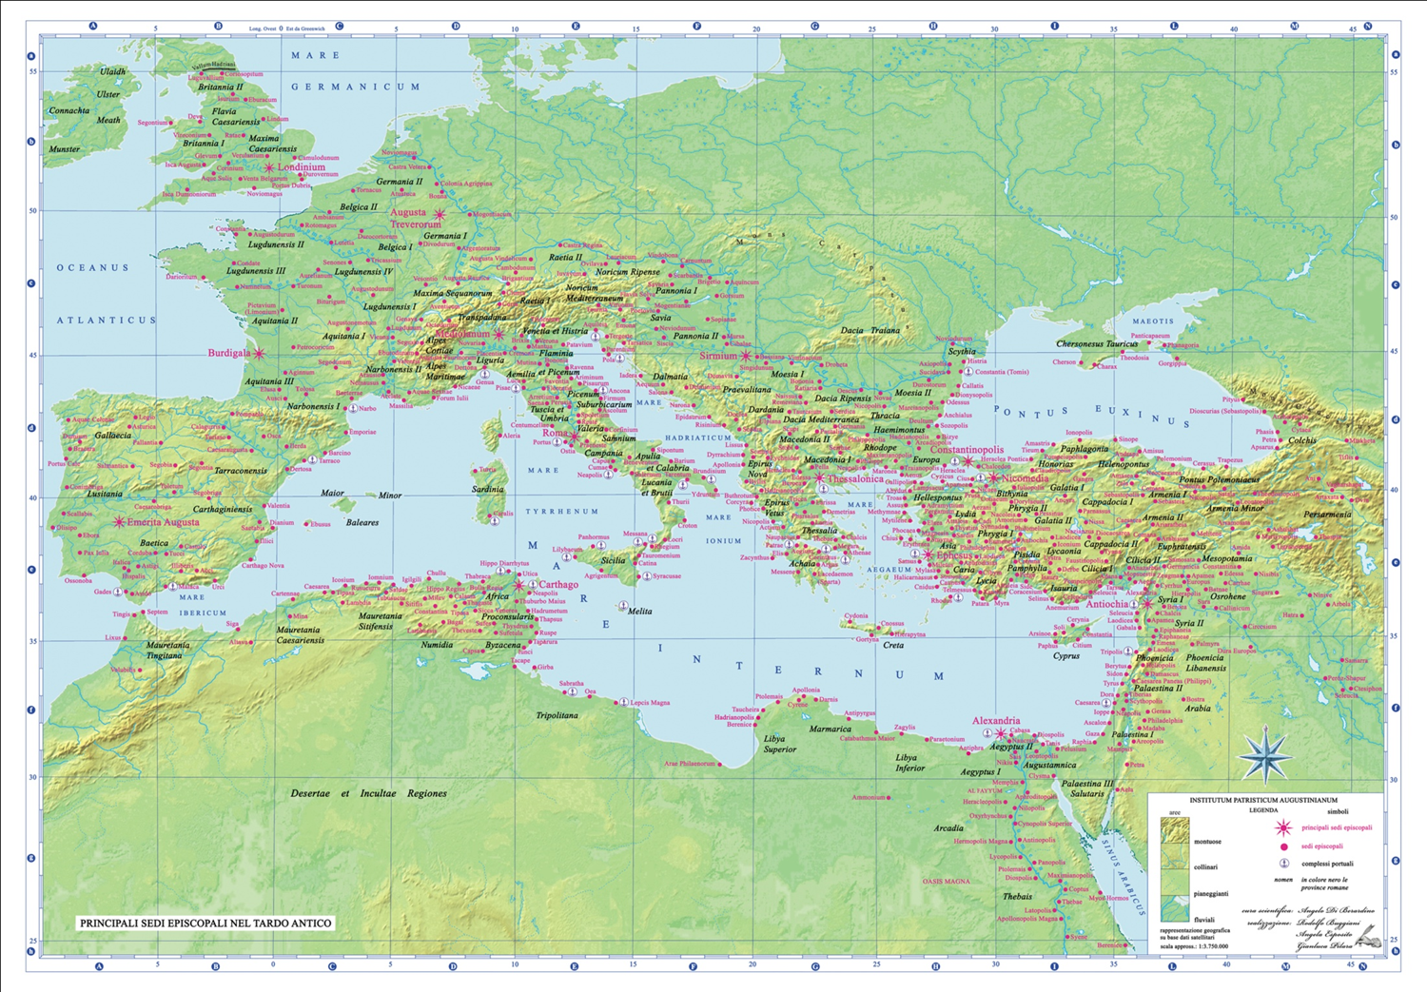

Slide 8
What did the church look like back then?
Not like our North American Churches today
Multi-cultural, but also ethnic enclaves
Primarily poor/middle class – but some wealthy members
Patron-client relationship (ex. Corinthian church)
Membership changes after 4th century – it has its privileges
Initially met in homes or synagogues (considered Jewish sect), but also had church buildings by at least end of 3rd century (Eusebius)
Dura Europa site, for example (Syrian house church)

Slide 9
The Material Culture

Slide 10
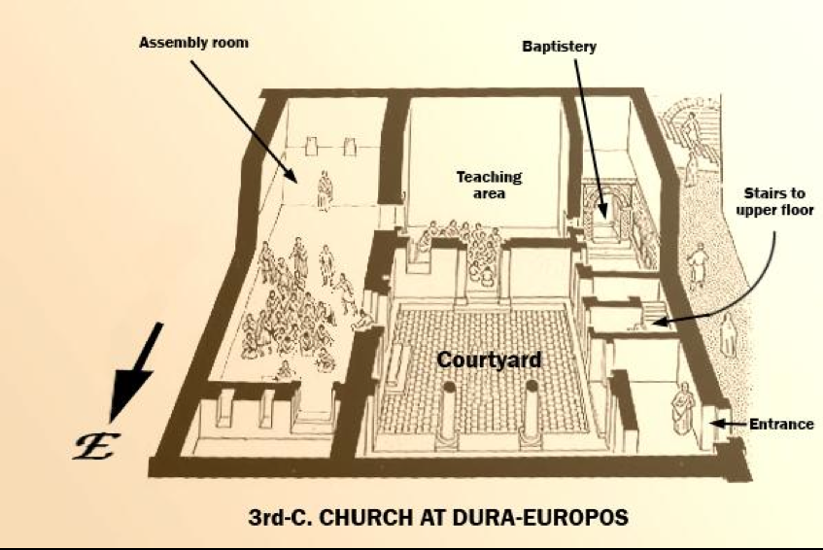
https://www.thebyzantinelegacy.com/dura-church

Slide 11
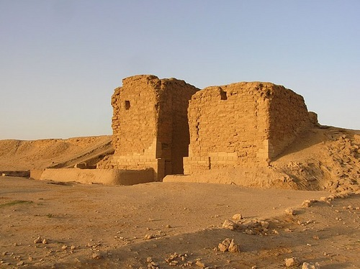

Slide 12
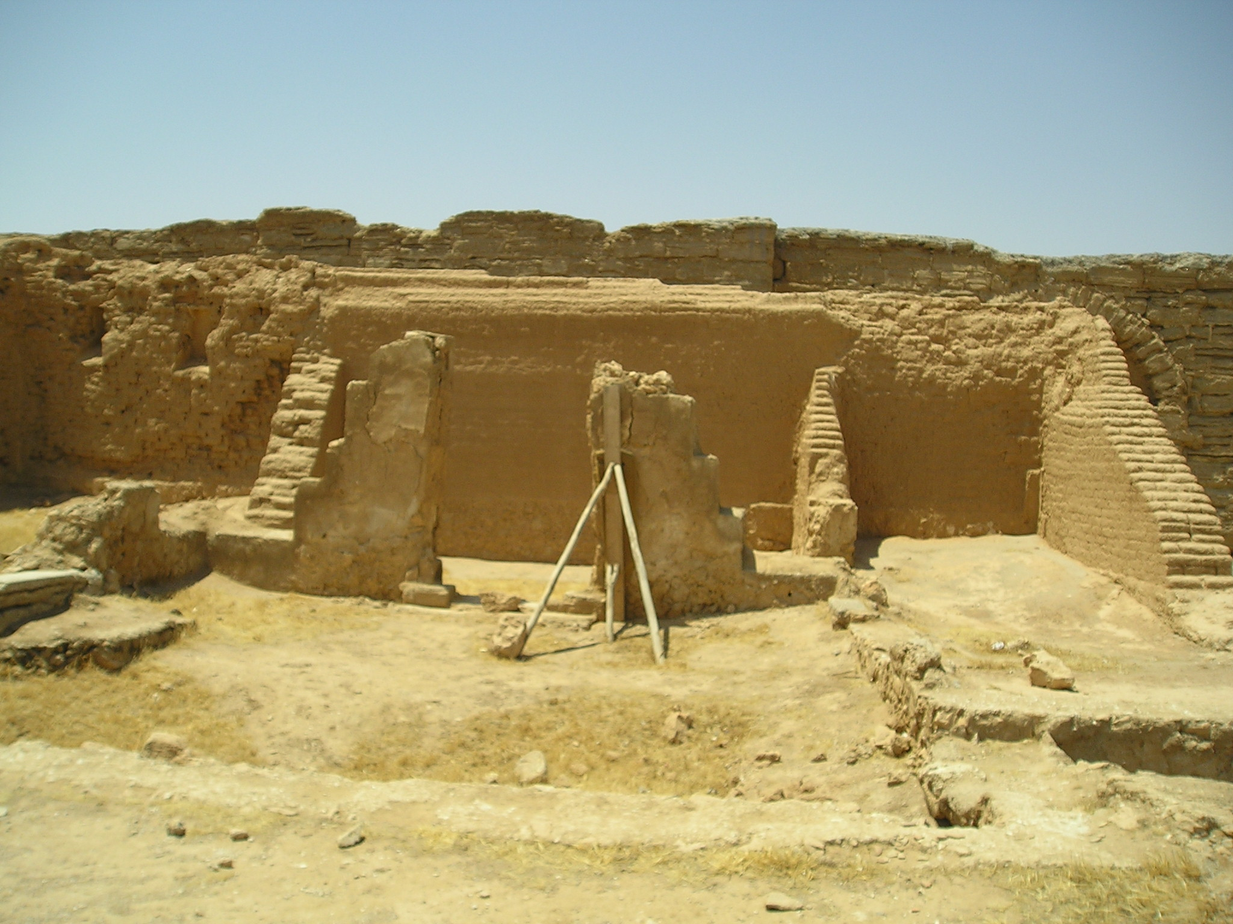

Slide 13
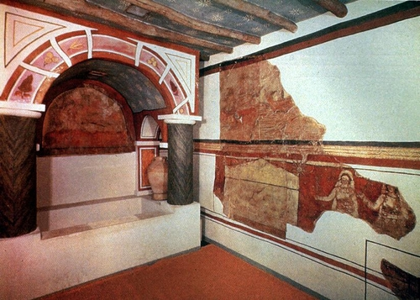

Slide 14
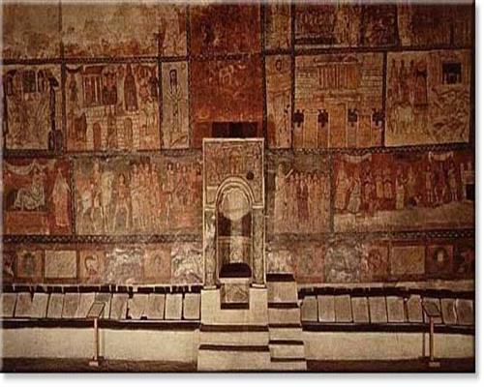

Slide 15
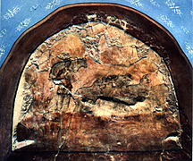

Slide 16
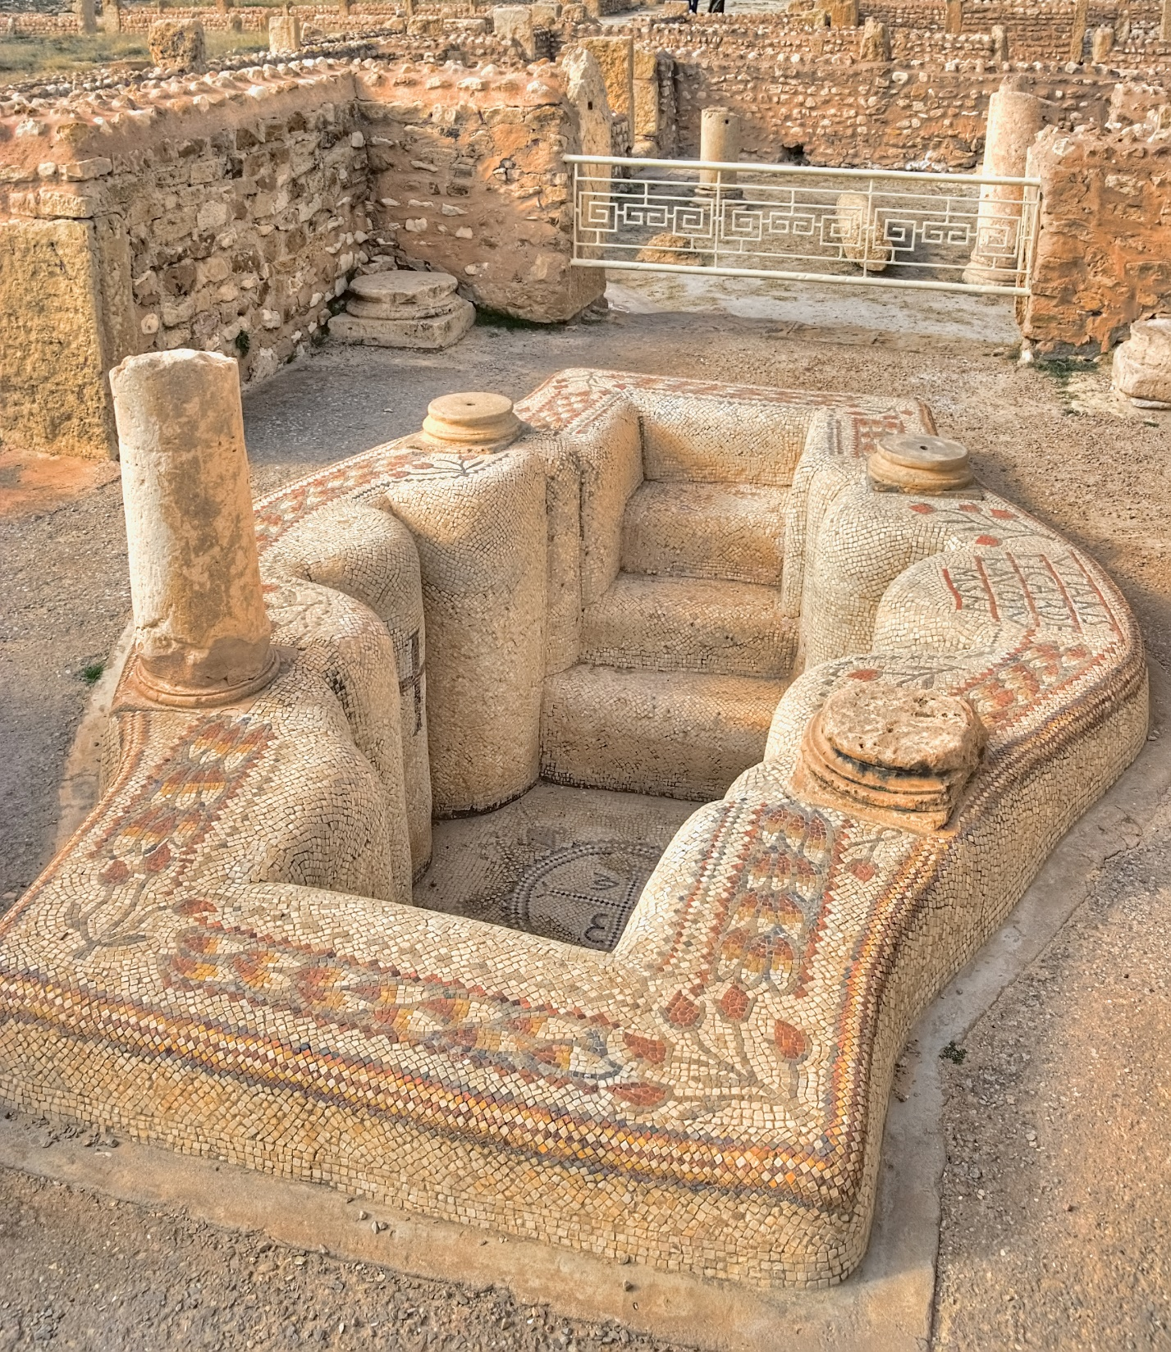
Sufetila

Slide 17
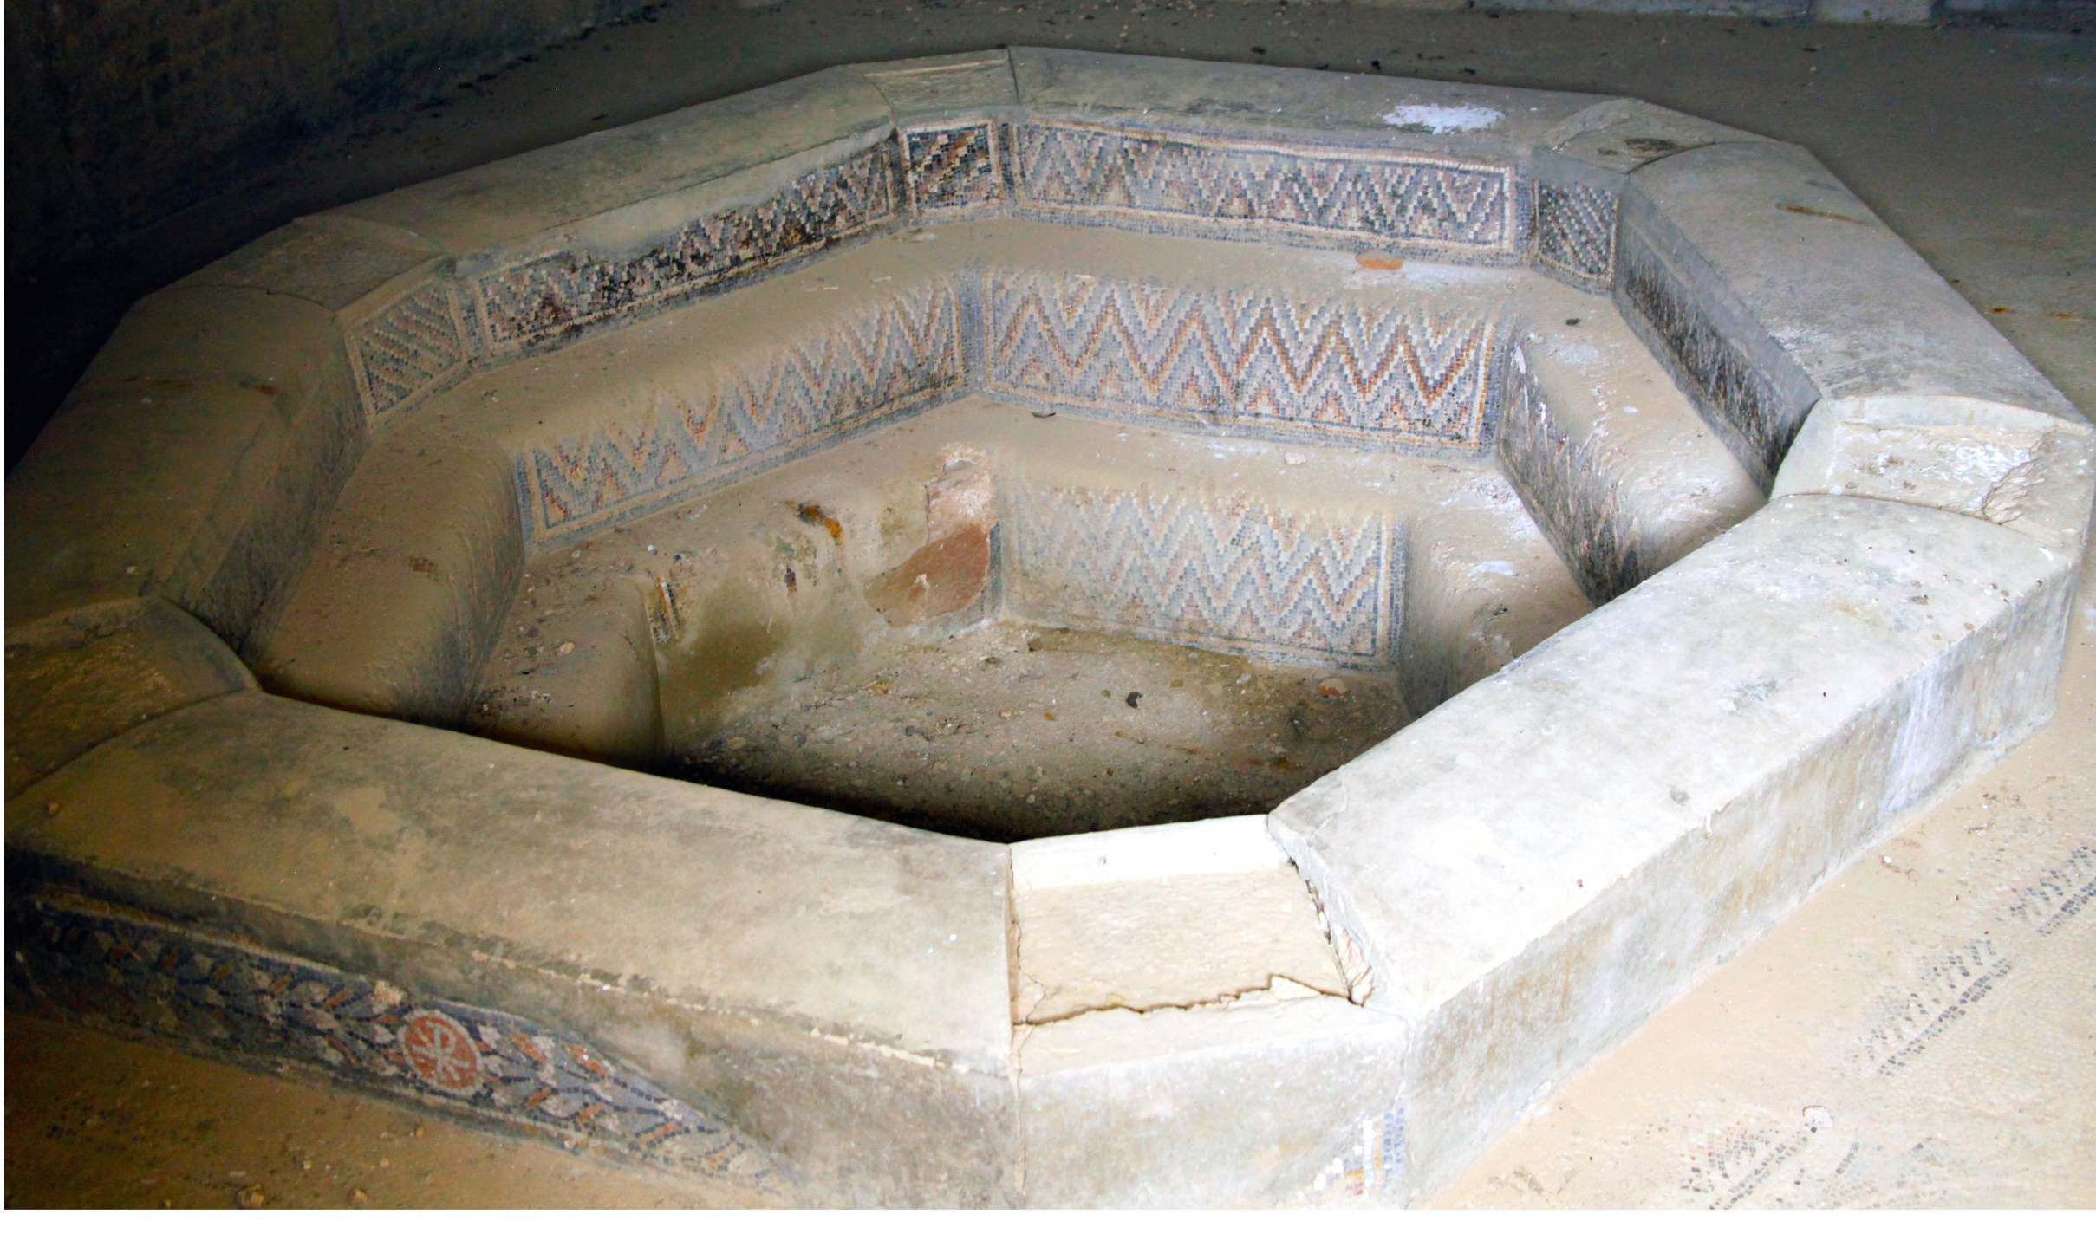
Timgad

Slide 18
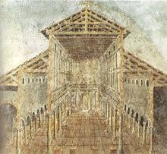
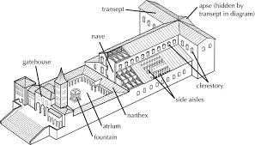
St. Peters Basilica – Rome, 4th century, Built by Constantine

Slide 19
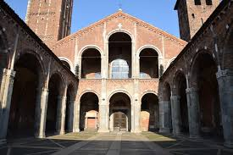
St. Ambrose Church in Milan

Slide 20
Outline of Major Eras
Early Church 33-451 AD

Slide 21
30-100 AD
The Apostolic Fathers
Didache
1 & 2 Clement
Epistle of Barnabas
Shepherd of Hermas
Polycarp
Letters of Ignatius of Antioch
Papias
Epistle to Diognetus
Domitian’s persecution (end of 1st. C)
150-250 AD
The Apologists & Heresiologists
Justin Martyr
Tatian
Athenagoras
Irenaeus
Tertullian
Origen
The First Century Church
Jesus, Apostles, Paul, John
Pentecost (33 AD)
Spread of Christianity (33-60s )
Writing of most of NT
Nero’s Persecution (60s)
Destruction of Jerusalem (70 AD)
100-150 AD

Slide 22
250-325 AD
325-381 AD
Councils of Nicaea and Constantinople
The Patristic
Golden Age
381-451 AD
Councils of Ephesus (431) & Chalcedon (451)
Patristic Golden Age, Part II
Persecution, Plague and Triumph of Constantine

Slide 23
Culture in the 21st Century?
The coarsening of American Culture
How Should churches Relate to their culture?

Slide 24
Outline of Lecture
1. What the Culture of the early church looked like
2. How the Church reacted to that culture
Outside of Worship
Inside of Worship
3. Conclusion

Slide 25
Nothing New Under the Sun
A shared common culture
Civic Religion

Slide 26
The Christian habitus
A way of living that led to a higher culture and a higher purpose – not withdrawal
Almsgiving (Mt 6:1-4),
care and deference for the poor and defenseless (Gal 2; James 2).
Care for the widows and the orphans as the weakest and most vulnerable in society (James 1:27).

Slide 27
The Christian Habitus
Obedience to Government Authorities (Romans 13:1-8)
Respect for parents and spouse (Ephesians 5-6)
Protect the foreigner (Hebrews 13:2)

Slide 28
How Did Christianity Grow?
No seeker services
Disciplina Arcanum?
3 year new members class
The Way of Life or the Way of Death

Slide 29
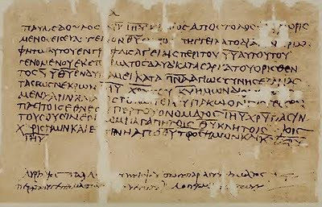
Growing Web of Connections
Patient ferment
Counter Cultural but not in your face
Epistle to Diognetus (2nd century)
“For Christians are not distinguished from the rest of humanity by country, language, or custom. For nowhere do they live in cities of their own, nor do they speak some unusual dialect, nor do they practice an eccentric way of life. This teaching of theirs has not been discovered by the thought and reflection of ingenious people, nor do they promote any human doctrine, as some do.”

Slide 30
Epistle to Diognetus 6
“But they live in both Greek and barbarian cities, as each one’s lot was cast, and follow the local customs in dress and food and other aspects of life, while at the same time demonstrating the remarkable and admittedly unusual character of their own citizenship. . . . They marry like everyone else, and have children, but they do not expose their offspring. They share their food but not their wives. They are in the flesh, but they do not live according to the flesh. They live on earth, but their citizenship is in heaven. They obey the established laws; indeed in their private lives they transcend the laws. They love everyone, and by everyone they are persecuted. They are unknown, yet they are condemned; they are put to death, yet they are brought to life. They are poor, yet they make many rich; they are in need of everything, yet they abound in everything. They are dishonored, yet they are glorified in their dishonor; they are slandered, yet they are vindicated. They are cursed, yet they bless; they are insulted, yet they offer respect. When they do good, they are punished as evildoers; when they are punished, they rejoice as though brought to life” (Epistle to Diognetus 6).

Slide 31
Household connections
Cornelius in Joppa (Acts 11:14)
Lydia in Philippi (Acts 16:15)
Paul’s jailor in Philippi (Acts 16:31)
Crispus in Corinth at the house of Titius Justus (Acts 18:7-8)
Along with their entire household
Households an extended affair

Slide 32
Work/Business connections
Tentmaker district of a city
“You remember, brothers, our work and toil. It was while we were laboring night and day, in order not to burden any of you, that we proclaimed to you the gospel of God: (1 Thess. 2:9).

Slide 33
Social Network - Tertullian
We don’t take the gifts and spend them on feasts, drinking-bouts, or fancy restaurants. Instead we use them to support and bury poor people, to supply the needs of boys and girls who have no means and no parents. We support the elderly confined now to their homes. We also help those who have suffered shipwreck. And if there happen to be any in the mines, or banished to the islands, or shut up in the prisons—for nothing but their fidelity to the cause of God’s Church—they then become the nurslings of the confession they hold [as we take them in to help them]. Primarily it is the acts of love that are so noble that lead many to put a brand upon us. “See,” they say, “how they love one another.” (Tertullian, Apology 39).

Slide 34
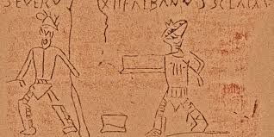
Sex in the City and Other Distractions
Gladiators/charioteers
Graffiti at Pompei – sex everywhere
Theater
Leaving Christ lying in the manger while rushing off to the theater to see “naked women swimming” (Chrysostom, Homilies on Matthew 7.6-7).
Constant bombardment of images

Slide 35
Christians Did not Live Indifferently
Theophilus of Antioch: Christians avoid sex outside of marriage and “are forbidden so much as to witness gladiator shows lest [they] become partakers and abettors of murders” (Theophilus of Antioch, Letter to Autolycus 3.15).

Slide 36
Clement of Alexandria and Ambrose
“. . . inhabiting the city, despises the things in the city which are admired by others. He lives in the city as in a desert, so that he may not be pressured into conforming to his environment, but instead chooses to exhibit a life lived justly” (Clement of Alexandria, Stromata 7.12)
“. . . living in the city [while] observing the rules of the monks, and ruling the Church with fasting and temperance. For the grace of the priesthood is much increased if the bishop constrain young men to the practice of abstinence, and to the rule of purity; and he would forbid them, even though they lived in the city, from taking up the manners and mode of life of the city” (Ambrose, Epistle 63.66).

Slide 37
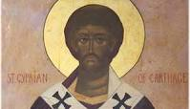
Cyprian – On Mortality 4-5
“Our warfare is with greed, with immodesty, with anger, with ambition. On top of that there is our diligent but toilsome wrestling with carnal vices, with enticements of the world. The mind of man besieged—and in every quarter infested with the onslaughts of the devil—can hardly meet the various points of attack, scarcely resists them. If greed is humbled, lust springs up. If lust is overcome, ambition takes its place. If ambition is despised, anger exasperates, pride puffs up, drunkenness entices, envy breaks concord, jealousy severs friendships; you are forced to curse, which the divine law forbids; you are compelled to swear, which is not lawful. There are so many persecutions the soul suffers daily, with so many risks is the heart wearied, and yet it delights to abide here long among the devil's weapons.”

Slide 38
Wealth and the Poor
“Whether the Rich Man Too Can be Saved” (Clement of Alexandria
Many Bishops close to the seat of power
Basil and the Basileiad: providing a “double relief.” Basil’s friend Gregory of Nazianzus (329-390) called Basil’s project a “new city,” the “storehouse of piety and the treasury of the wealthy . . . where disease is regarded in a religious light, and disaster is thought a blessing, and sympathy is put to the test” (Gregory of Nazianzus, Oration 43.35, 63).

Slide 39
The Early Church and Her Liturgy
Prosper of Aquitaine (ca. 390-ca.455): legem credendi statuat lex supplicandi (the law of praying establishes the law of believing).
Ethiopian Orthodox Tewahedo Church, Christology and their anaphora

Slide 40
Fathers Didn’t Do church – they lived it
In the culture but not of the culture
Basilicas
Liturgical clothing
Jerome: “The Divine religion has one dress in the service of sacred things, another in ordinary intercourse and life.”

Slide 41
Word and Sacrament – Two Foci
Unity between OT and NT in the Cross and Christ
“Hodie” = today – what happened then is happening now in the life of the church

Slide 42
“Hodie” – Today (Cyril of Jerusalem)
Now turn from the old to the new, from the figure to the reality. There we have Moses sent from God to Egypt; here, Christ, sent forth from his Father into the world: there, that Moses might lead forth an afflicted people out of Egypt; here, that Christ might rescue those who are oppressed in the world under sin: there, the blood of a lamb was the spell against the destroyer; here, the blood of the Lamb without blemish Jesus Christ is made the charm to scare evil spirits:

Slide 43
Hodie
there, the tyrant was pursuing that ancient people even to the sea; and here the daring and shameless spirit, the author of evil, was following you even to the very streams of salvation. The tyrant of old was drowned in the sea; and this present one disappears in the water of salvation. (Mystagogical Lecture 1.3 )

Slide 44
Lex Orandi et Lex Credendi
Believe, then, that at the invocation of the priest the Lord Jesus is present Who said: “Where two or three are, there am I also.” Matthew 18:20 How much more where the Church is, and where His Mysteries are, does He promise to impart His presence!
You went down, then (into the water), remember what you replied to the questions, that you believe in the Father, that you believe in the Son, that you believe in the Holy Spirit. The statement there is not: I believe in a greater and in a lesser and in a lowest person, but you are bound by the same guarantee of your own voice, to believe in the Son just as you believe in the Father; and to believe in the Holy Spirit just as you believe in the Son, with this one exception, that you confess that you must believe in the cross of the Lord Jesus alone [i.e. neither the Father or the Spirit died on the cross] (Ambrose, On the Mysteries 1.5.27-28).

Slide 45
Pope Benedict XVI
Paying less attention at times to the rite of the Most Holy Sacrament constitutes a sign and a cause of the darkening of the Christian sense of mystery, such as when Jesus is not the centre of the Mass, but rather a community preoccupied with other things instead of being taken up and drawn to the only one necessary: their Lord. If the figure of Christ does not emerge from the liturgy, it is not a Christian liturgy

Slide 46
Conclusion – Christ at the Center
Addressing “hot button” issues
Chrysostom, Homilies on the Statues
Summary of the Law
Worship of God
Service to our Neighbor

